Slide 1

Roslyn-Powered Standards Automate Team Conventions
Peter hellmuth
Nhdnug - March 20th, 2025

Slide 2
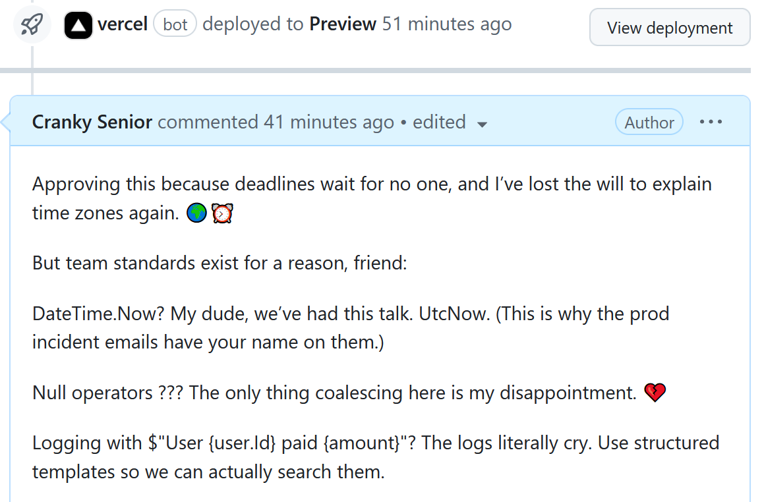
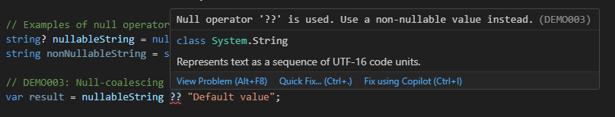
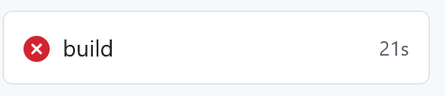
Why automate standards?
Writing paragraphs on pull requests
Vs.
A few squigglies

Slide 3
What is Roslyn?
.NET Compiler Platform ("Roslyn")
Open-source compiler for C# and Visual Basic
Provides APIs for code analysis and transformation
Powers Visual Studio's IntelliSense, refactoring, and code analysis

Slide 4

Syntax tree
Foundation of Roslyn analysis
Tree representation of code structure
Preserves all source information
Each node = language construct

Slide 5
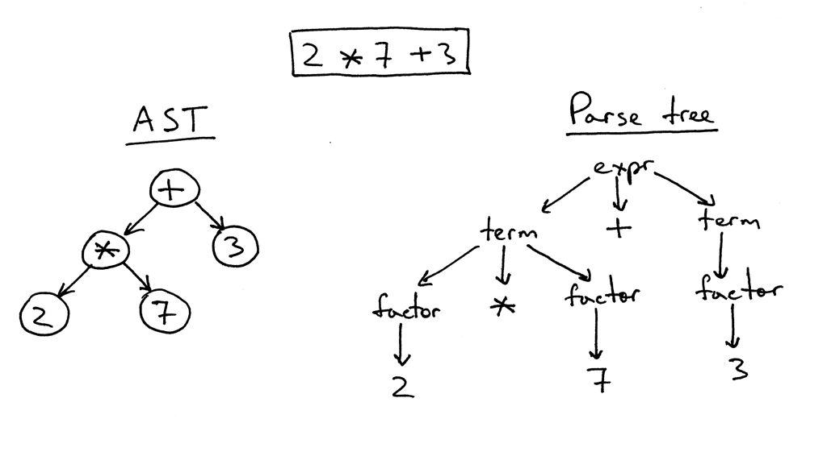
Syntax tree semantics

Slide 6
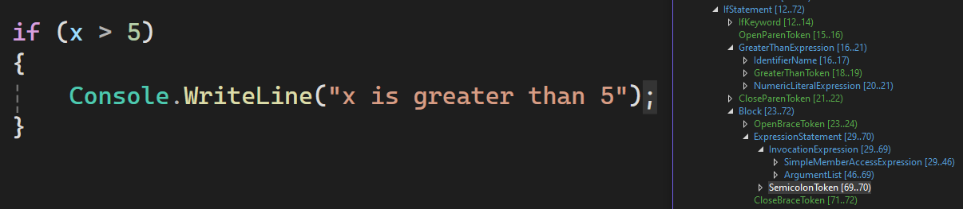
Roslyn Syntax tree

Slide 7
Roslyn analyzers
Visitor Pattern:
Register for specific syntax node types
Call actions when matching nodes are encountered
Generate diagnostics in editor and at build time
Register code fixes for automatic remediation in editor

Slide 8
Roslyn analyzers - Context and Reporting
SyntaxNodeAnalysisContext provides:
Access to the current node
Semantic model for deeper analysis
Location information for diagnostics
Method to register action for specific syntax node types (RegisterSyntaxNodeAction)
Method to report issues (ReportDiagnostic)

Slide 9
Roslyn analyzers - Demo

Slide 10

Resources
Popular Analyzer Packages:
StyleCop
Roslynator
AsyncFixer
Analyzer Testing Tools
Microsoft.CodeAnalysis (XUnit, NUnit, MSTest)
RoslynTestKit
https://github.com/PeterHellmuth/roslyn-analyzer

